Slide 1


Volume rendering via
Data-parallel primitives
M. Larsen, S. Labasan, P. Navrátil,
J.S. Meredith, and H. Childs (2015)
Course Instructors:
Dr. Preeti Malakar
Dr. Soumya Dutta.
By:
Dasari Charithambika (210302)
Divya Gupta(210353)

Slide 2


Introduction
Various hardware architectures are used in supercomputers, including GPUs, many-core coprocessors, large multi-core CPUs, low-power architectures, hybrid designs, and experimental designs.
Visualization software must be developed in a manner that obviates the need for porting all visualization algorithms to all architectures
Visualization software often contains large code bases and employs a variety of algorithms.

Slide 3

Introduction
Existing algorithms cannot be simply “ported" into every new framework
This work has presented a volume rendering algorithm built entirely from data-parallel primitives, operating on unstructured mesh data.
This algorithm melds naturally into an existing distributed-memory algorithm as well

Slide 4

Contribution Of This Work
Description of a new volume rendering algorithm composed of data-parallel primitives.
Evaluation of the algorithm on CPU and GPU architectures.
Exploration of the variation in performance characteristics across architectures, which informs how effective data-parallel primitives are at hiding architectural details.
Comparison to community standard volume renderers which do not make use of data-parallel primitives.

Slide 5

Related Work
Data-Parallel Primitives
Unstructured Volume Rendering
Tools used in parallel computing to distribute data across multiple processors
Dax, EAVL, and PISTON are merging into a single product (VTK-m)
While the foundations of combined product development have been established, a significant gap remains in specific algorithm development.
Our study addresses this gap by introducing a critical visualization algorithm to the field.
A combination of color and transparency to allow users to see the entirety of a three-dimensional volume
Projected tetrahedra method
Ray-caster for unstructured data
Z-Sweep is an algorithm that advances a plane through the volume in depth.
Childs et al developed a parallel algorithm, the descendent of Z-Sweep, which is closely related to our algorithm.

Slide 6

Data-Parallel Primitives
Map
Gather and Scatter
Computational work-horse of data-parallel primitives.
It is body of a for loop, where each iteration of the loop can be executed independently
Copies items in parallel from the input arrays to the output arrays, where the input arrays are of length n and the output arrays are of length m
ReverseIndex
Reduce
Scan
A specialized Scatter operation that can generate the set of indices to be used in subsequent Gather operations when passed a Boolean array of flags specifying whether each input element is included in the set.
It is the Operations that combine the input values of an array to a single output value
Ex:-
Summing all the values in an array.
Finding the maximum value in an array.
Like Reduce, has loop-carried dependencies, but the output is an array instead of a single value, and the result at each point in the output array is the partial reduction up to that point

Slide 7

Algorithm
The algorithm is a sampling-based approach for rendering images, aiming to fill a large buffer with W × H × S samples, where W and H represent image width and height, and S is the depth of samples.
To manage memory efficiently, the algorithm divides the sampling process into passes, with each pass focusing on a different section of the buffer based on depth.
This approach allows for early ray termination, identifying opaque pixels after each pass, which helps reduce computational overhead and memory requirements.

Slide 8

Each pass consist of four phases:
8
Pass
Selection
Initialization
Step
Screen Space
Transformation
Compositing
Sampling

Slide 9

Initialization Step
9
Calculate the minimum and maximum depth of each tetrahedron using camera transform and and storing the smallest and largest depths in respective arrays.
This is accomplished with a Map primitive
2. Pass Selection
Identify which cells can possibly contribute to a sample.
Constructing a Boolean array of size N for N cells, True if the corresponding cell can possibly contribute, and False otherwise
The second step of this phase is to create an array of tetrahedrons that can contribute samples during this pass
This is accomplished by successive use of four data-parallel primitives: Reduce, Exclusive Scan, Reverse Index and Gather.

Slide 10
3.Screen Space Transformation
10
Uses a Map primitive to transform the active tetrahedrons into screen space using the camera transform.
The result of this phase is an array of m tetrahedrons.
4.Sampling
Using the axis-aligned bounding box (AABB) , the sampler considers every possible pixel and depth that the cell could contribute to and extracts barycentric coordinates.
An array containing pixel opacities serves as input. The sampling functor can use this data to make decisions, allowing it to potentially terminate sampling early, much like early ray termination.
5. Compositing
The functor uses the samples and pixel information to composite the color for that pixel, at least with the samples seen so far.

Slide 11
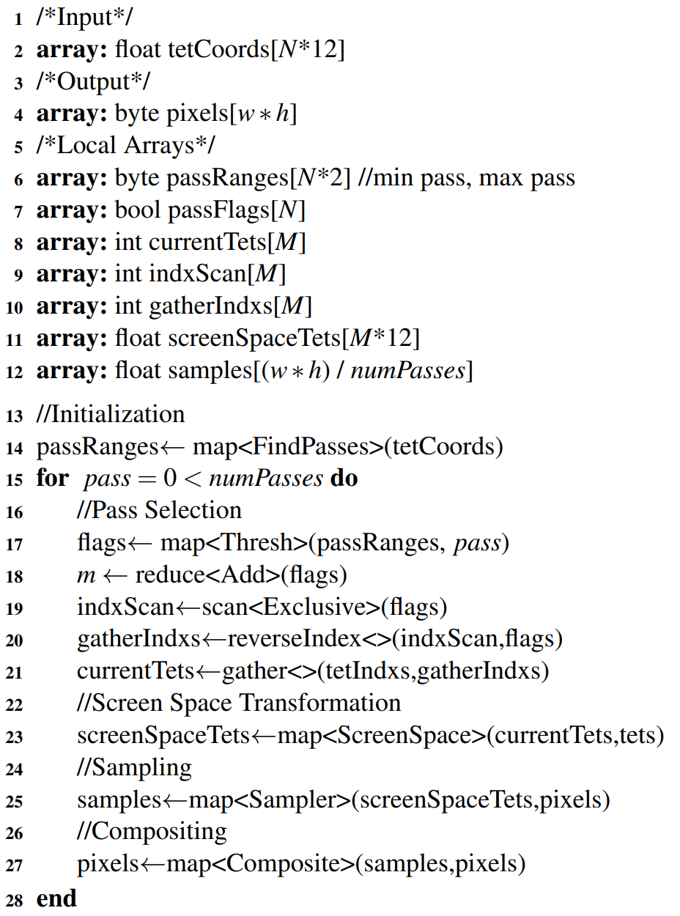

11
Data-Parallel Primitives Pseudocode

Slide 12
Our Testing Options
12
Hardware Architectures:
CPU1: NERSC’s Edison machine, where each node contains two Intel “Ivy Bridge" processors, and each processor contains 12 cores, running at 2.4 GHz. Each node contains 64 GB of memory.
CPU2: the same configuration as CPU1, but using only one of the 24 cores.
CPU3: An Intel i7 4770K with 4 hyper-threaded cores (8 virtual cores total) running at 3.5GHz, and with 32 GB of memory.
GPU1: An NVIDIA GTX Titan Black (Kepler architecture) with 2,880 CUDA cores running at 889 MHz, and with 6 GB of memory

Slide 13
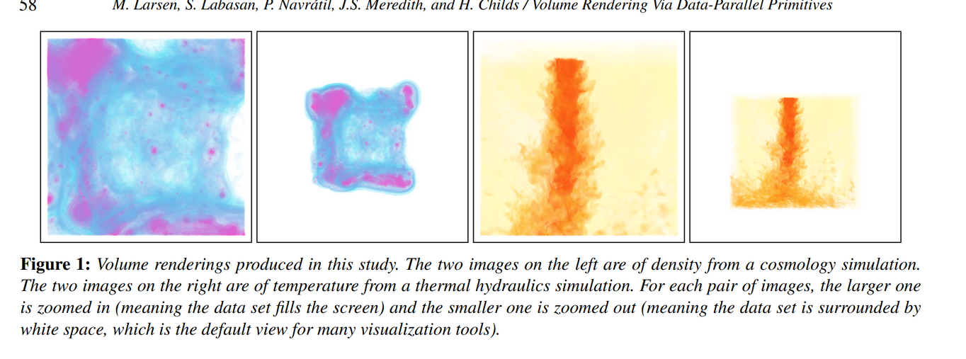
2. Data Sets
13
Enzo-1M: a cosmology data set. This data set was natively on a rectilinear grid, which was then decomposed into tetrahedrons. The total number of tetrahedrons - 1.31 million.
Enzo-10M: a 10.5 million tetrahedron version of Enzo1M.
Nek5000: a 50 million tetrahedron unstructured mesh from a thermal hydraulics simulation.
Enzo-80M: an 83.9 million tetrahedron version of Enzo1M.
3. Camera position
Volume renderings for these data sets, including the zoomed out and zoom in camera positions.

Slide 14
14
Performance Measurements
On CPU1, we enabled PAPI(Performance application programming interface) performance counters to measure the total instructions executed and total cycles during each phase of the algorithm
on GPU1, the nvprof profiler was used to measure total instructions issued, instructions executed, total cycles, registers per thread, and achieved occupancy.
For each of the community standards, we used that software’s built-in timing infrastructure.

Slide 15
15
Study Overview
Configuration
Our study consisted of two rounds and 56 total tests.
Round-1: Evaluation of Data-Parallel Primitives
This round was designed to better understand the basic performance of our volume renderer. It varied three factors
Hardware architecture (CPU and GPU): 2 options
Data set: 4 options
Camera position (zoomed in and zoomed out): 2 options

Slide 16
16
CPU Performance
As the data size grows, the overall time also goes up.
The amount of work is proportional to the number of samples, as well as the number of cells.
In small data sets like Enzo-1M, the extraction of the samples dominates the overhead for handling each cell.
For Enzo-80M, the sampling time is nearly the same for both camera positions
This is because the number of samples extracted has nearly doubled, so the majority of the time is being spent iterating over tetrahedrons.

Slide 17
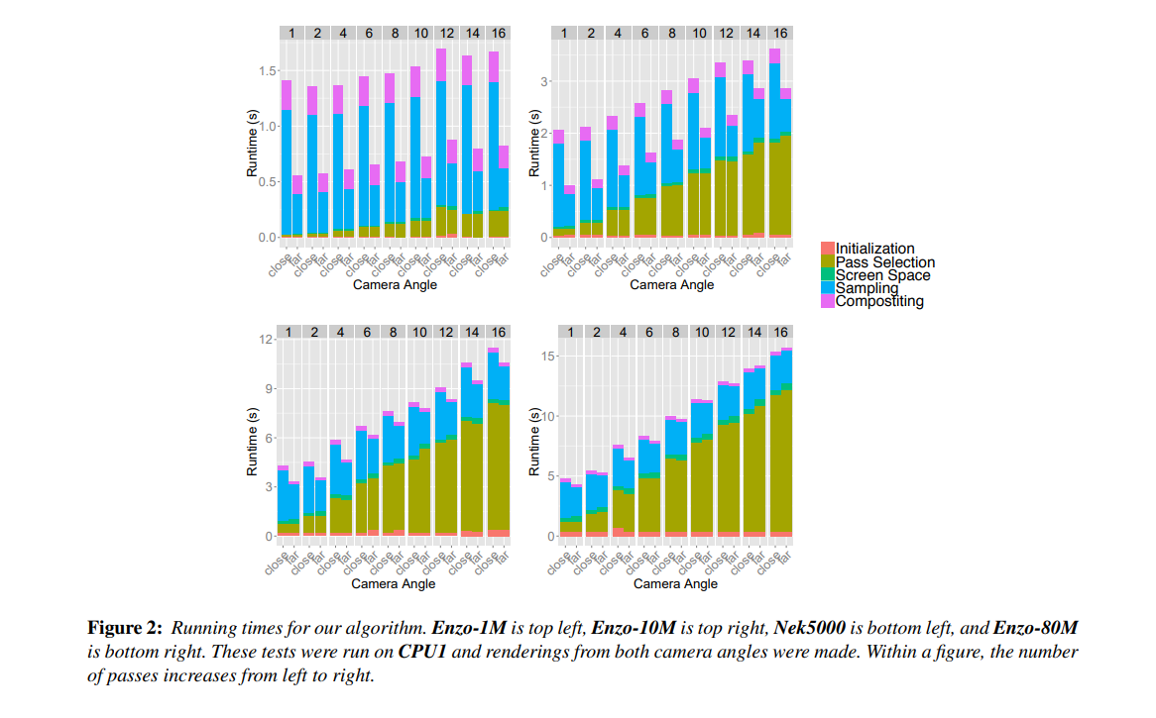
17

Slide 18
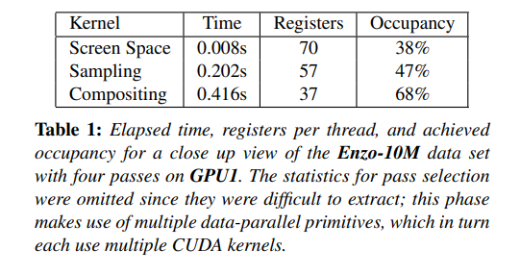
18
GPU Performance
While the dominant factor for CPU performance is sampling time, the dominant factor for GPU performance is compositing time

Slide 19
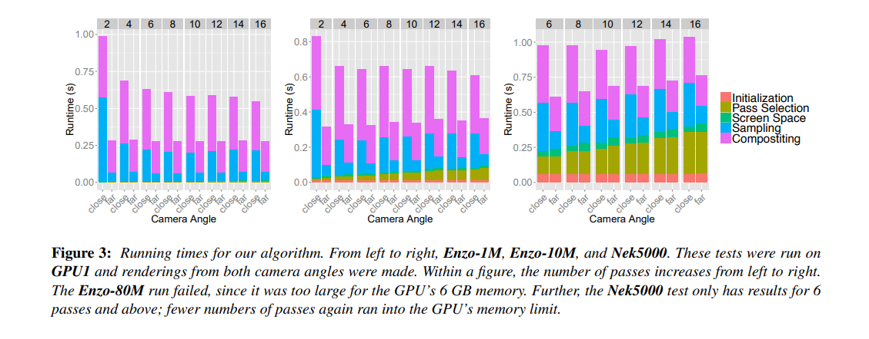
19

Slide 20
20
Assessing Performance Portability
The instructions per cycle (IPC) indicates how data-intensive the computation is.
Pass selection should have a low IPC value.
The screen space and sampling phases both have high IPC values.
The CPU performs as anticipated, while the GPU excels in compute-intensive tasks. However, the efficiency of data-intensive activities like pass selection and compositing depends on the specific use case.
Portable performance achieved through data-parallel primitives is generally effective, but there are still challenges and limitations to be aware of, indicating that optimization opportunities and pitfalls exist in this context.

Slide 21
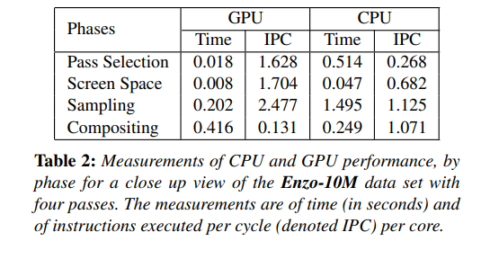
21

Slide 22
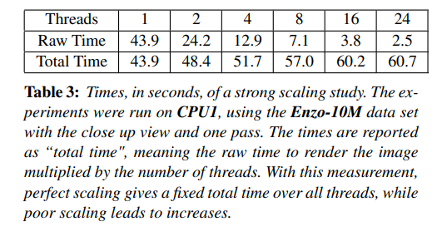
22
Scalability
While adding threads does lead to a dropoff of 50% up to 24 threads (the number of CPU cores on the node), the algorithm appears to scale generally well overall.

Slide 23
Round-2: Comparison With Community Software
23
We would be comparing the algorithm to existing standards for the following unstructured data:
the HAVS volume renderer on the GPU
the integration-based ray-caste on the CPU
sampling-based ray-caster in VisIt on the CPU.
2. This round has 24 tests (3X4X2).

Slide 24
Round-2: Comparison With Community Software
24
HAVS
A projected tetrahedron algorithm.
HAVS involves sorting geometry and then rasterizing it, with the sorting step typically performed on the CPU and the sorted geometry transferred to the GPU for rendering.
Instead, the study evaluated a parallel radix sort on GPU1 for different data sizes and presents the sorting time.

Slide 25
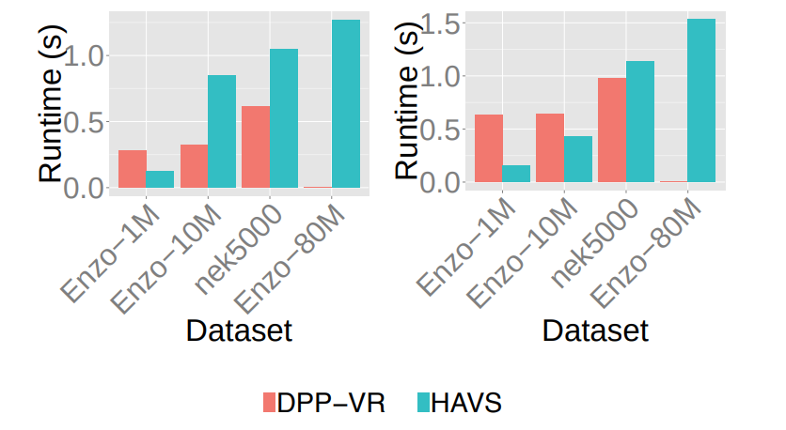
Round-2: Comparison With Community Software
25
RESULTS
ZOOMED-OUT
ZOOMED -IN
Our algorithm is slower than HAVS when zoomed in (due to the evaluation of a large number of samples) but faster than HAVS when zoomed out (with fewer samples to evaluate).
Our algorithm didn't slow down as quickly as HAVS when data size increased.

Slide 26
Round-2: Comparison With Community Software
26
2. Unstructured Ray-Caster
The study compared the our algorithm running on a CPU to the unstructured ray-caster implemented in VTK
To address the scalability issues, the study switched to the CPU3 architecture, where the VTK implementation performed better, ensuring a more fair and meaningful comparison.’
This algorithm has a pre-processing step to trace face connectivity.

Slide 27
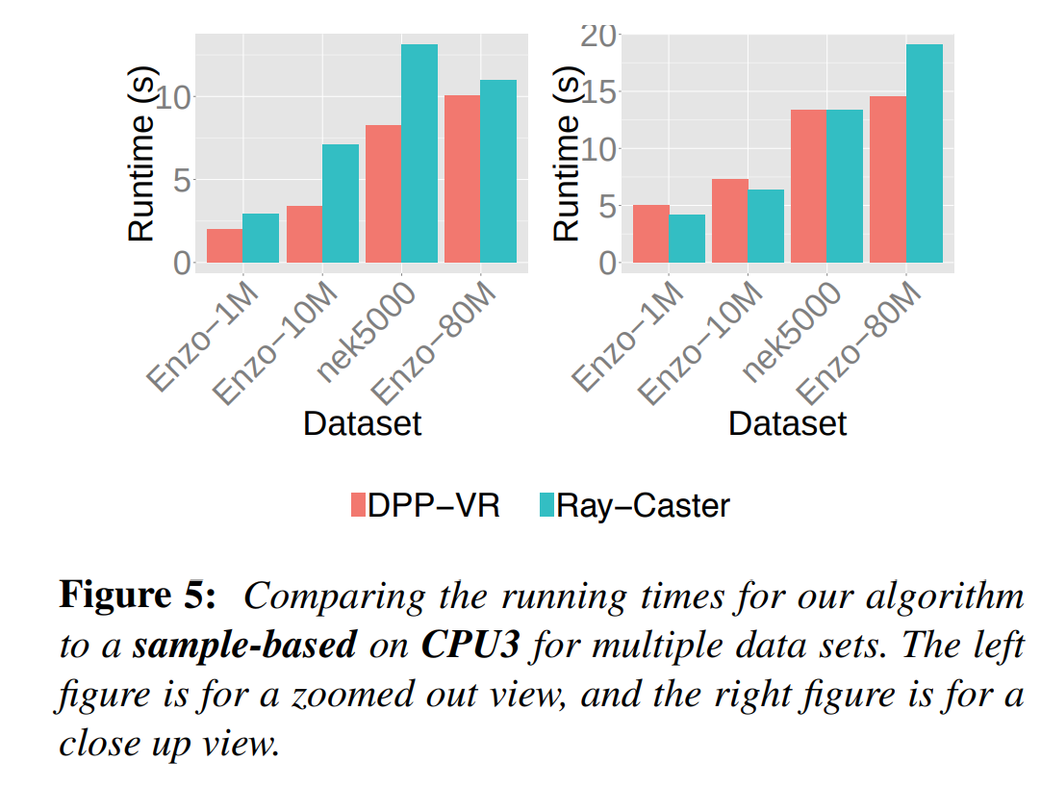
Round-2: Comparison With Community Software
27
RESULTS
Our algorithm performed faster on larger data sets, while the results were mixed on smaller data sets.

Slide 28
Round-2: Comparison With Community Software
28
3. Sampling-based ray-caster in VisIt
This algorithm transforms cells into image space, slices them with planes aligned with columns of pixels, and then extracts lines along those planes in depth.
Designed for distributed-memory parallelism, which involves redistributing samples for compositing after sampling.
In this comparison, VisIt was executed in serial mode, and our algorithm was also run using CPU2 to maintain hardware parity.

Slide 29
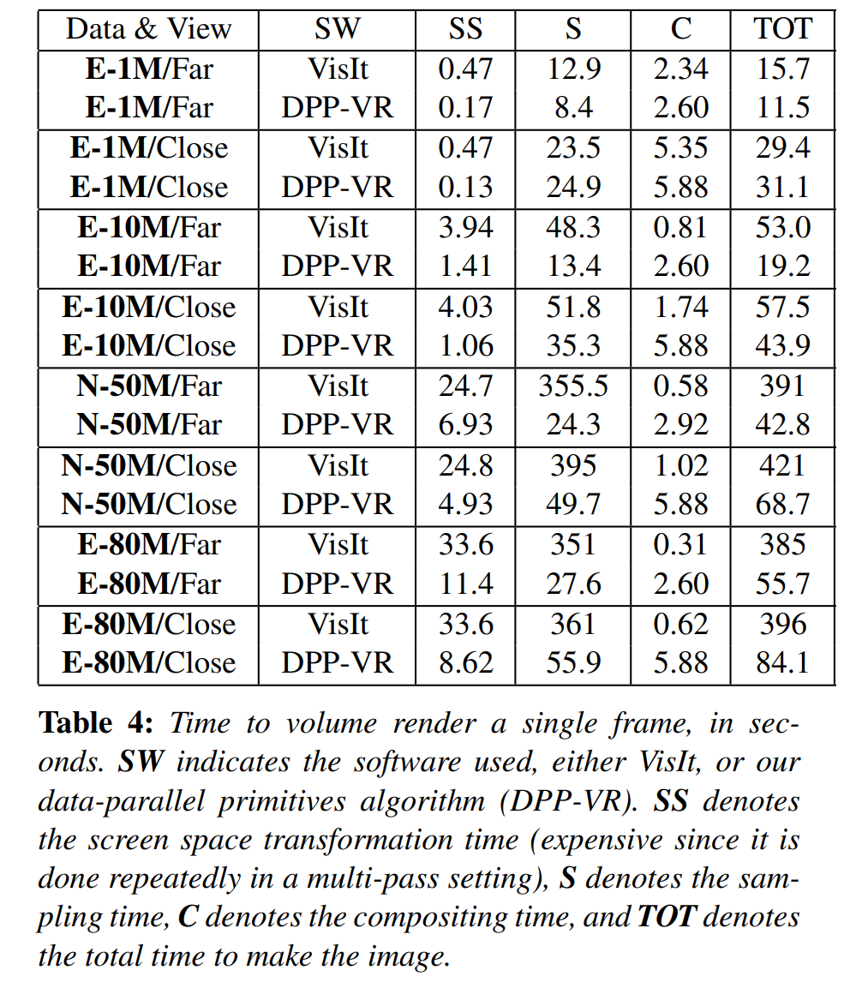
Round-2: Comparison With Community Software
29
3. VisIt
RESULT
VisIt’s approach is beneficial with large cells (i.e., Enzo-1M), since it is amortizing its calculations. But our approach is faster with small cells(i.e., Enzo-80M), since the overhead VisIt pays per cell is no longer amortized away.
VisIt uses an early ray termination criteria, leading to lower compositing times.
Overall, our algorithm is giving better performance compared to this algorithm which is optimized for a specific platform
Time to volume render a single frame(sec)

Slide 30
Conclusion
30
We presented a new algorithm for unstructured volume rendering that can composed entirely of data-parallel primitives.
Moreover,because the algorithm used data-parallel primitives , the real advantages are benefits in portable performance, longevity and programmability.
Each new algorithm re-thought in terms of data-parallel primitives, including this one, enables the advancement of data-parallel primitive-based infrastructures that can run on multiple architectures.

Slide 31
Conclusion
31
In terms of future work, this algorithm is planned to be extended to distributed memory parallelism.
This work melds well with the distributed-memory algorithm, the natural extension is to replace its sampling and compositing phases with our data-parallel primitive approach.

Slide 32
References:
32
[CDM06] CHILDS H., DUCHAINEAU M., MA K.-L.: A Scalable, Hybrid Scheme for Volume Rendering Massive Data Sets. In Proceedings of Eurographics Symposium on Parallel Graphics and Visualization (EGPGV) (Braga, Portugal, May 2006)
CALLAHAN S. P., IKITS M., COMBA J. L. D., SILVA C. T.: Hardware-assisted visibility sorting for unstructured volume rendering. Visualization and Computer Graphics
MORELAND K., AYACHIT U., GEVECI B., MA K.- L.: Dax Toolkit: A Proposed Framework for Data Analysis and Visualization at Extreme Scale. In Proceedings of the IEEE Symposium on Large-Scale Data Analysis and Visualization
MEREDITH J. S., AHERN S., PUGMIRE D., SISNEROS R.: Eavl: the extreme-scale analysis and visualization library.
[WMFC02] WYLIE B., MORELAND K., FISK L. A., CROSSNO P.: Tetrahedral projection using vertex shaders. In Proceedings of the 2002 IEEE symposium on Volume visualization and graphics

Slide 33
33
THANK YOU !

